Slide 1

IST 261 (Fall 2019)
Application Development Design Studio I
JUnit – Part 1
Phil O'Connell
pxo4@psu.edu

Slide 2
Unit Testing
Unit Testing is testing small portions (units) of your program
As opposed to running the full program, and testing overall
Programmers will unit test before the QA department tests it
They may also create automated unit tests
Typically for new projects or import changes made to existing code
Nightly build scripts will also run the unit tests
Any accidentally broken code will be caught before release

Slide 3
Unit Testing Frameworks
There are several frameworks that provide unit testing
TestNG (Java)
xUnit variations
JUnit (Java), NUnit (C#), RUnit (R)
Some frameworks are used to test web UI
Selenium (used by Katalon, Protractor)
Some frameworks are used to test desktop UI
Microsoft Test Manager (MTM)
We will use this

Slide 4
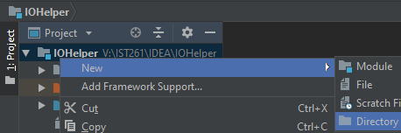
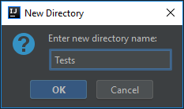
Create Tests Directory
We need a place to put our test classes
Right-click on the project
New → Directory
Tests
Hit OK

Slide 5
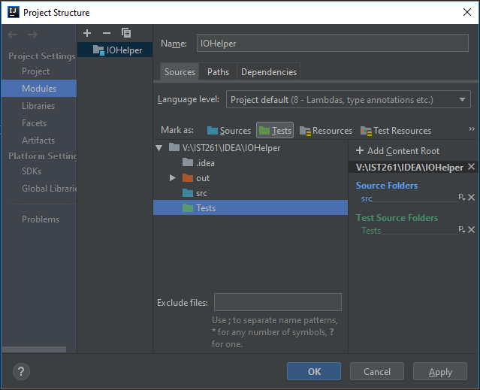

Tell IDEA That Tests Will Hold Test Classes
Click once on the project to highlight it
Hit F4 to open Module settings
Click Tests
Highlight Tests
Then it will be listed as a "Test Source"

Slide 6
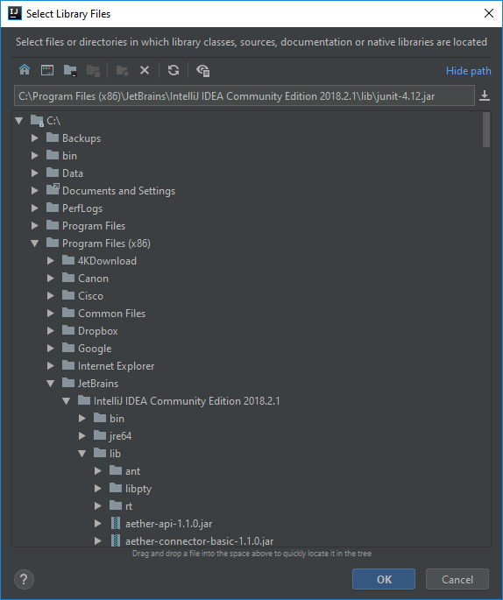
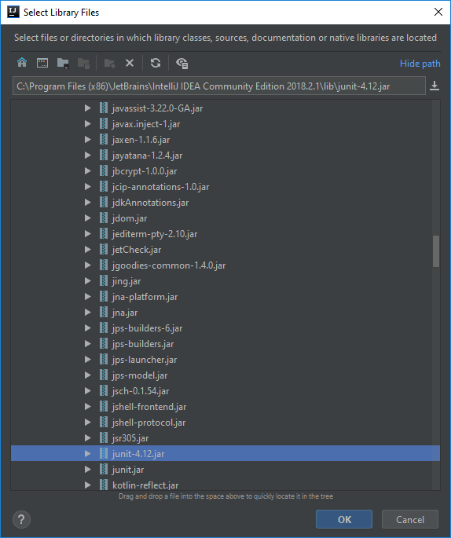
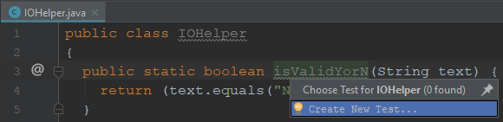
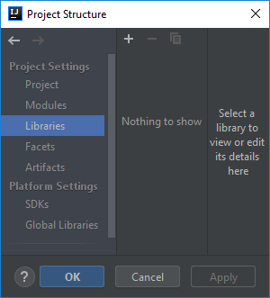
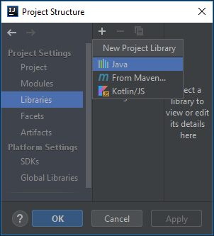
Add a Test Class
Open IOHelper.java
Move cursor onto isValidYorN method
Hit Ctrl-Shift-T
Choose Create New Test

Slide 7
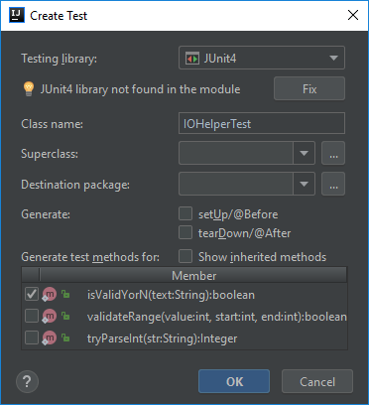
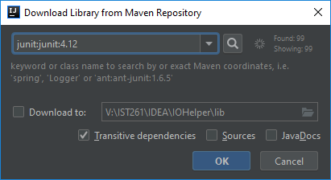
Add JUnit to Project
Choose JUnit4
"JUnit library not found..."
Hit Fix
Choose junit:junit:4.12

Slide 8
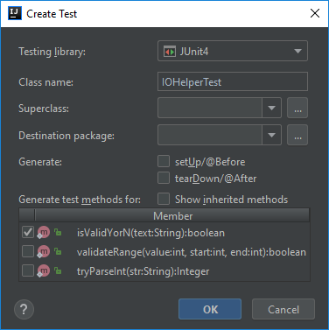
Add a Test Class
Choose isValidYorN
Hit OK

Slide 9
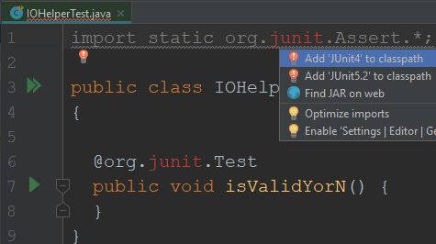
Add 'JUnit4' to classpath (may not be needed for IDEA v2019)
You'll have a new IOHelperTest.java file
It won't compile
You need to click on junit
Hit Alt-Enter
Choose Add 'Junit4' to classpath
Change @org.junit.Test to just @Test
Change to just @Test

Slide 10

Rename the Test Method
We'll use a naming convention for the tests
method__scenario__expectation
Two underscores between the scenario and expectation
One underscore between words in the scenario and expectation
If testing the value "Y" against isValidYorN, we expect it's valid
So we call that test method: isValidYorN__Pass_Y__Returns_True

Slide 11
Add an Assertion
Assertions are the checks that decide if a test passes or fails
There are many kinds
For today, we'll just look at these two:
assertTrue
assertFalse

Slide 12
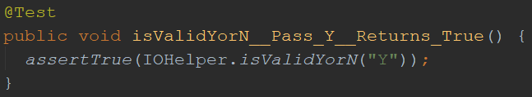
AssertTrue
assertTrue accepts a Boolean value
If that Boolean is true, then it will pass the test
If false, then it will fail the test
We name this test method isValidYorN__Pass_Y__Returns_True
If we pass "Y" to isValidYorN we expect it should return true

Slide 13
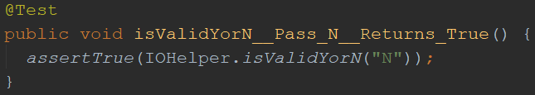
AssertTrue
We can make a similar test for "N"
We name this test method isValidYorN__Pass_N__Returns_True
If we pass "N" to isValidYorN we expect it should return true

Slide 14

AssertFalse
assertFalse accepts a Boolean value
If that Boolean is false, then it will pass the test
If true, then it will fail the test
We name this test method isValidYorN__Pass_x__Returns_False
If we pass "x" to isValidYorN we expect it should return false

Slide 15
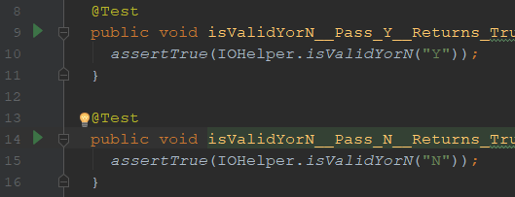

Run the Tests
There are several different ways
Run them individually by choosing the run button on the left

Slide 16
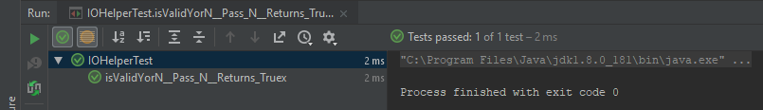
See the Test Results
At the bottom of the screen, you'll see the "Test Runner" pane

Slide 17
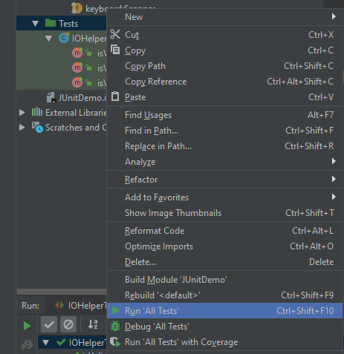
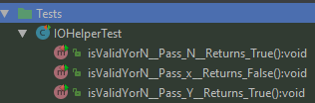
Run All Tests
Highlight the Tests folder
Hit Ctrl-Shift-F10 or use menu
You can even highlight the project and do the same thing to run all tests in the project

Slide 18

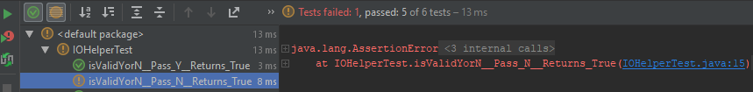
A Failed Test
Just to demonstrate a failure, I'll edit the test
Click on the .java link to take you to the source code

